Slide 1
Document Summarizer Guided By: Dr. Vasudeva Varma
Prepared By:- Group No. 27
Ashrith Jalagam(201202126)
Shefali Soni(201405619)
Aditya Lunawat(201405559)
Mentored By : Litton J Kurisinkel

Slide 2
Introduction
Document Summarizer is a platform used to generate the summaries using pre-defined summarizers and get the most relevant summary by passing it to a model.
The relevancy of a document with respect to Computer Science is determined using WordToVec model and get the most relevant summary out of it.
Various pre-built systems such as Apache-tika, WordToVec models have been used for buiding the platform. This platfrom can further be used by other developers.

Slide 3
Motivaton
Several summarizers makes it difficult to judge which summarizer suits the best for a scenario.
Ability of the platform to test different summarizers based on a domain helps the developers to make a choice.
This can be achieved by rating the documents based on their relevancy achieved.

Slide 4
Proposed Approach
Crawl the data and create a corpus of related to Computer Science domain and create a model using WordToVec tool.
Given a URL/file, extract the textual content and create a summary using different summarizers.
Pass the summaries one by one to the WordToVec model and get the relevancy of the summaries with respect to computer science.

Slide 5
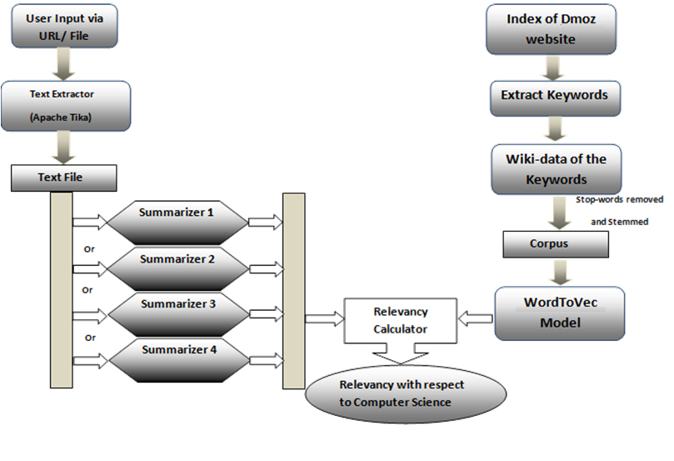
Architecture

Slide 6
Working of Document Summarizer

Slide 7
Modules
Corpus Creation
Text Extraction
Summary Generation
Relevancy Calculation

Slide 8
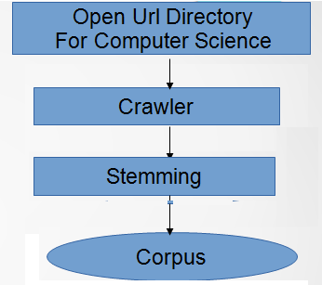
Corpus Creation

Slide 9
Corpus Creation
Define a crawler that will crawl through the Dmoz website and get the desired data.
Get the wikipedia pages of all of these keywords and store them in a text file which is the corpus of our system.
The wiki pages are being accessed using the Apache-tika tool to get the pages.

Slide 10
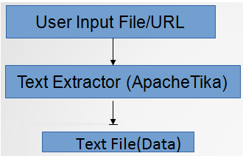
Text Extraction
Input for the system can be an URL or any type of file such as pdf, excel, odt, odp etc.These type of files must be converted to text file for
the summarizers to manipulate.
This work is done using Apache-tika tool. Read the input from either the URL or the file, pass it to Apache-tika API and collect the output stream and write it to a file.

Slide 11
Summarization
Four Different Summarizers were used to generate the summary for each parsed text document/URL.
Summarizer 1 : This Summarizer simply tokenizes the given document and splits it into sentences. Then, it calculates the rank of each sentence according to the TF-IDF Model.
Summarizer 2 : This Summarizer is similar to the previous one but has a “min” and a “max” threshold. So, only those sentences are considered which lie in that range.

Slide 12
Summarization
Summarizer 3/4 : In these summarizers, there is an inbuilt tokenizer and stemmer, uses help of nltk to rank the final sentences.
Summarizer 5 : This summarizer is the “Open Text Summarizer”. This summarizer gives us the best relevant results based on the summary ratio we provide to it as input.

Slide 13
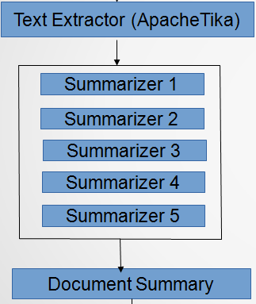
Summarization

Slide 14
Summarization
There are a available set of summarizers added to the system and more summarizers can be added to the framework.
User chooses among the available summarizers and generate the summary.
These summaries are being forwarded to the model for relevancy calculation

Slide 15
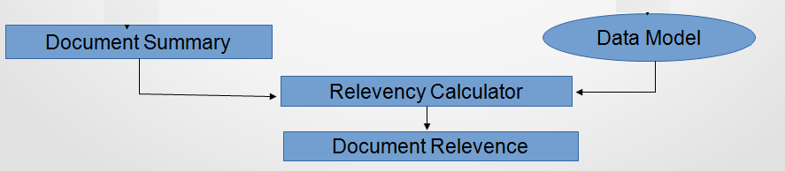
Relevancy Calculation

Slide 16
Relevancy Calculation
The input to the model is the textual summary from all the summarizers. Pass the summary one by one to the model.
Based on certain parameters the model gives the relevancy factor as the output to all the summaries.
Based on this factor the user decides, which summary suits the most to the domain.

Slide 17
Applications
News Feed (Relevancy based on searched category) which means analysing the news and displaying only the summary of the news rather than displaying the whole content.
Developed as a platform for the researchers working on summarization as they can add new features to this project.

Slide 18
Conclusion
The project has been developed as a platform into which new summarizers can easily be added.
Ease for developers to decide which summarizer works best for their domain by testing their data on the summaries and calculating the relevance factor.
Now the file factor is not the point for the developer’s to think. Input any type of file or URL to the platform.

Slide 19
References
Open Url Directory For Computer Science
(http://www.dmoz.org/Computers/Computer_Science
WORD2VEC model
Link: http://radimrehurek.com/gensim/index.html
Summarizers
http://glowingpython.blogspot.in/2014/09/text-summarization-with-nltk.html
https://pypi.python.org/pypi/sumy/0.3.0
http://pythonwise.blogspot.in/2008/01/simple-text-summarizer.html

Slide 20
Thank You

